Slide 1

DEPARTMENT OF COMPUTER SCIENCE & ENGINEERING
SCHOOL OF COMPUTING
10214CS501
COMMUNITY SERVICE PROJECT
WINTER SEMESTER(2024-2025)
REVIEW - II
CAREER COMPASS: CHARTING YOUR PATH TO SUCCESS
SUPERVISED BY
Faculty Name MS S HASHINI
M.E.,Assistant Professor
PRESENTED BY
1. UTUKURU SAI SANATH (VTU26583)(23UECS0904)
2. SYED JAFFAR HUSSAIN (VTU24674)(23UECS0889)
3. BANDARI CHARAN (VTU26582)(23UECS0673)

Slide 2
Agenda
ABSTRACT
OBJECTIVE
INTRODUCTION ABOUT VILLAGE
ACTIVITY LOG
SURVEY
SURVEY ANALYSIS WITH REPORT
SOCIETY RELEVANT PROBLEM IDENTIFICATION
NOVEL IDEA GENERATION
PROTOTYPE/DEVELOPMENT OF NEW SOLUTION
GEOTAGGED PHOTOS AND DETAIL&VIDEO LINK
AUTHENTICATED SIGNATURES PROOF AND DETAIL
PLAGIARISM REPORT

Slide 3
ABSTRACT
Personalized Career Assessments:
Identify strengths, interests, and values.
Explore career paths aligned with aspirations.
Expert Guidance:
Access detailed job descriptions and educational resources.
Receive professional advice for career planning and decision-making.
Career Tools:
Build resumes, prepare for interviews, and search for jobs.
Gain the skills to stand out in the job market.
Mentorship and Networking:
Connect with mentors and industry experts.
Gain valuable insights and build professional relationships.

Slide 4
OBJECTIVES
Aim of the Project :-
To guide the students by showing the steps to reach their goals in education sectors.
Scope of the Project :-
To Identify the strength, weakness and interest on particular sector.
Explore learn about future trends and in demand skills.
Setting clear goals and breaking them into actionable steps.
Suggestions on skill development through social medias .(Like You tube, Google, etc)
Motivating to participate curricular activities.
Suggesting people’s to play games(like sudoku, chess , ......etc) to sharp their mind not to divot on other things.

Slide 5
INTRODUCTION ABOUT VILLAGE
Sullurpet, a vibrant town in Andhra Pradesh holds historical, cultural, and strategic significance . Sullurpet Municipality was established as a Grade-III Municipality on 21st January 2012, covering 17.68 sq. km. It is located 94 km from the district headquarters in SPSR Nellore District, Andhra Pradesh. The town serves as the gateway to the Satish Dhawan Space Center (SHAR), Sriharikota, 17 km away. The population was 45,782 as per the 2011 Census (22,062 males and 23,720 females). The current estimated population is approximately 48,500. Climate & RainfallSullurpet experiences a tropical climate, with winters from November to February and summers from March to June. Annual rainfall averages 84 mm, mostly between November and January.
Key Attractions:-
Satish Dhawan Space Center (SHAR): India’s primary spaceport for ISRO, located 17 km away.

Slide 6
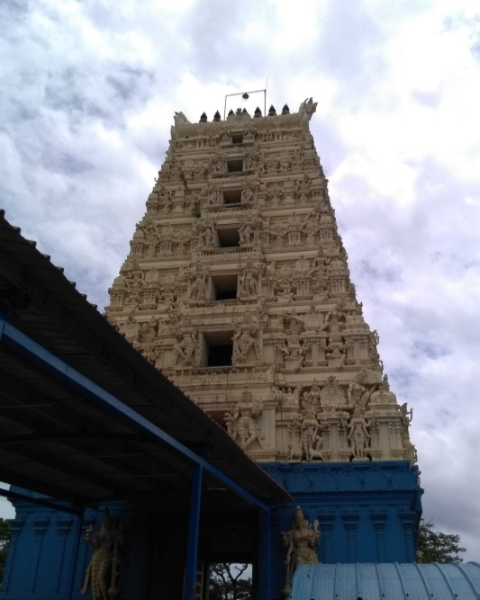
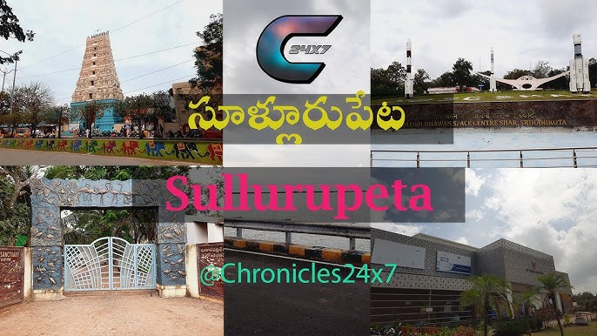
Pulicat Lake: India’s second-largest brackish water lagoon, renowned for its migratory bird species, including flamingos and pelicans.
Chengalamma Parameswari Temple: A 4th-5th century temple located on the Kalangi River, known for its “Tirunallu” and “Teppotsavam” festivals.
Mannar Swamy Temple: A 16th-century temple located in Mannarpoluru, Sullurpet, along the Kalangi River.
Hazrat Dawood Shah Wali Dargah: Asia’s tallest dargah, featuring a 144-foot-long mazar and attracting 20,000 pilgrims monthly.

Slide 7
ACTIVITY LOG(10 Days mandatory)
Day/Date | Brief Description of the daily activity | Learning Outcome
Day 1 | Planned the project introduction at school | Learned to structure and organize presentations
Day2 | Prepared materials for the school visit | Improved skills in creating visual aids
Day3 | Rehearsed the project Introduction speech | Built confidence in public speaking
Day4 | Conducted the first round of project introductions | Gained experience in engaging with an audience
Day5 | Gathered feedback from students and staff | Learned how to incorporate constructive input

Slide 8
Day/Date | Breif Description of the Daily Activity | Learning Outcome
Day6 | Adjusted the presentation based on feedback | Practiced adaptability and iterative improvement
Day 7 | Conducted follow-up sessions with more students | Improved communication and interpersonal skills
Day 8 | Shared specific career guidance tips | Enhanced the ability to provide tailored advice
Day 9 | Reviewed the overall response to the project | Developed evaluation and reflective thinking
Day 10 | Compiled a report on the outcomes of the project | Mastered summarizing and documenting experiences

Slide 9
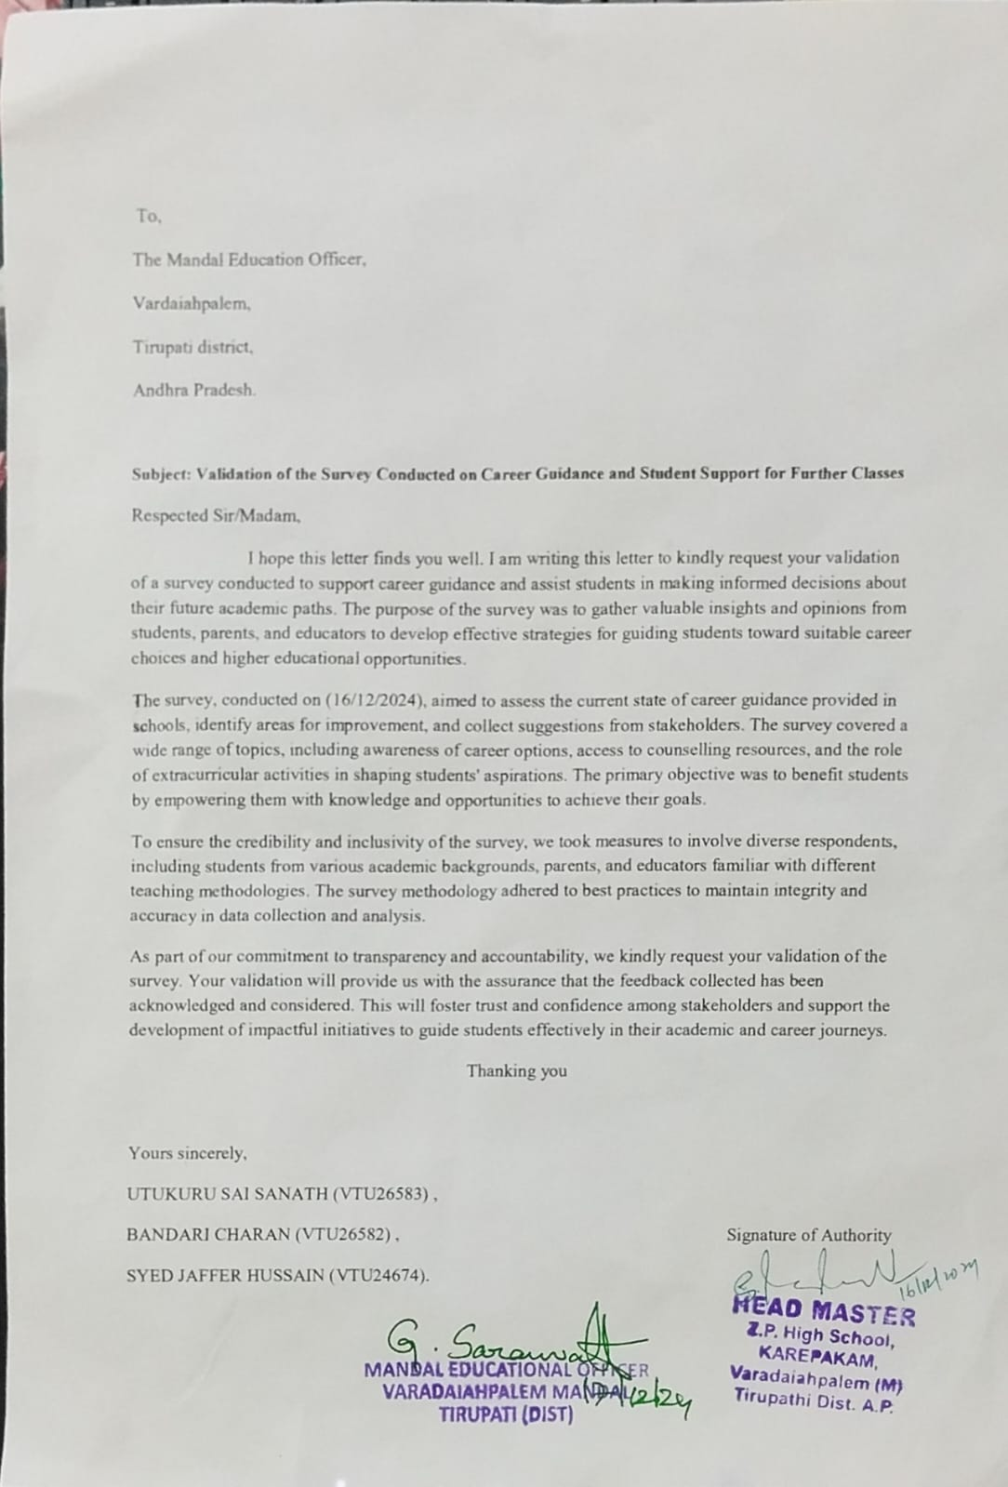
SURVEY-DETAILS
*With Hardcopy Screen Shot

Slide 10
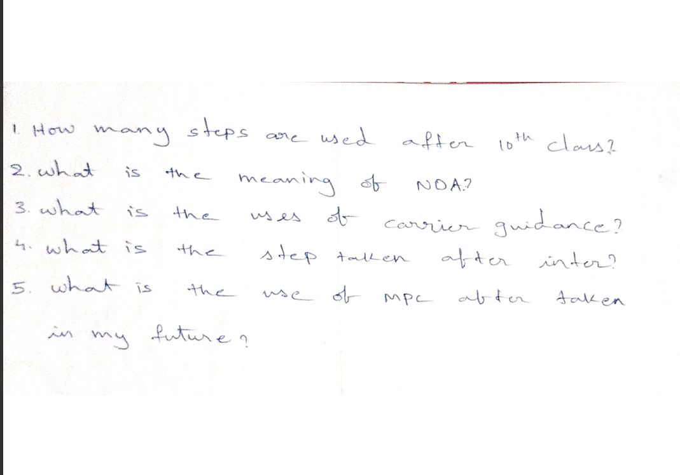
SURVEY ANALYSIS

Slide 11
SURVEY ANALYSIS

Slide 12
SOCIETY RELEVANT PROBLEM IDENTIFICATION
Lack of Access: Not all students have access to quality career guidance services, especially those from low socio-economic backgrounds.
Information Gap: Students often lack accurate and up-to-date information about the latest introduced courses and career options.
Parental Influence: Parents may influence career choices without having the necessary knowledge, leading to poor career decisions.
Social Inequality: Career guidance can perpetuate social inequality if not accessible to all students equally.
Inadequate Training for Counselors: Career counselors may not be well- trained, affecting the quality of advice.
Peer Pressure: Students might make career choices based on peer pressure rather than their own interests and aptitudes.

Slide 13
PROTOTYPE/DEVELOPMENT OF NEW SOLUTION
Engaging Parents and Peers: Provide support materials for parents and create community forums where students can exchange their experiences.
Personalized Advice: AI tools to give customized career advice based on students' interests and skills.
Updated Info: Regularly updated information about careers, job trends, and education paths.
User-Friendly Design: A website and app that are simple for students to navigate and use effortlessly.
Modern Tech: Use of VR and AI chatbots for immersive career exploration and 24/7 support.

Slide 14
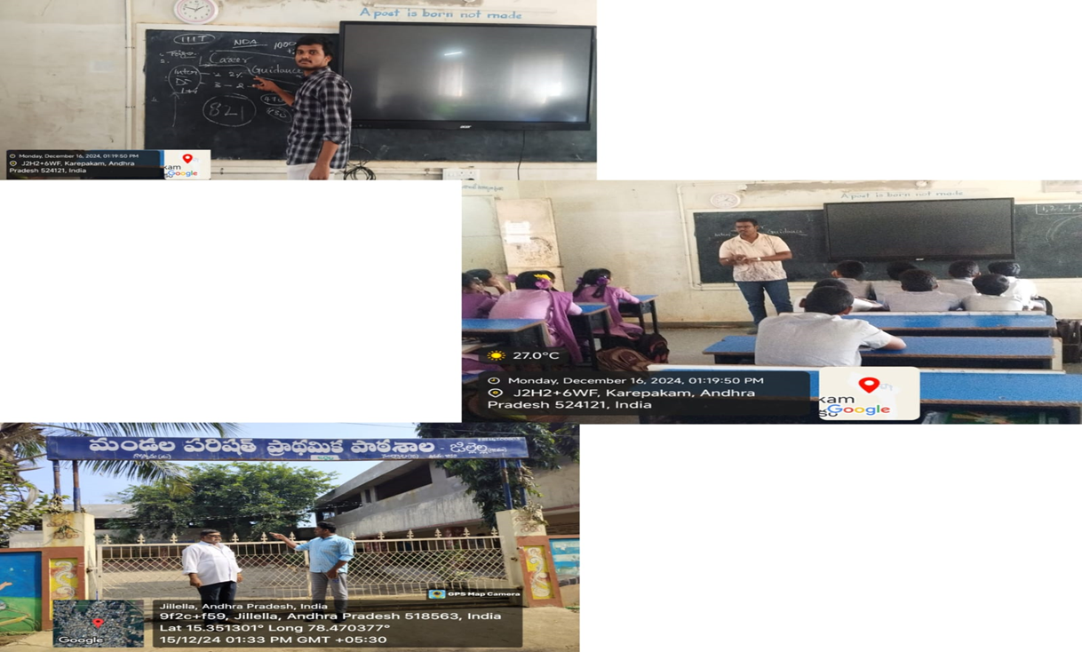
GEO TAGGED PHOTOS ,VIDEO LINK

Slide 15
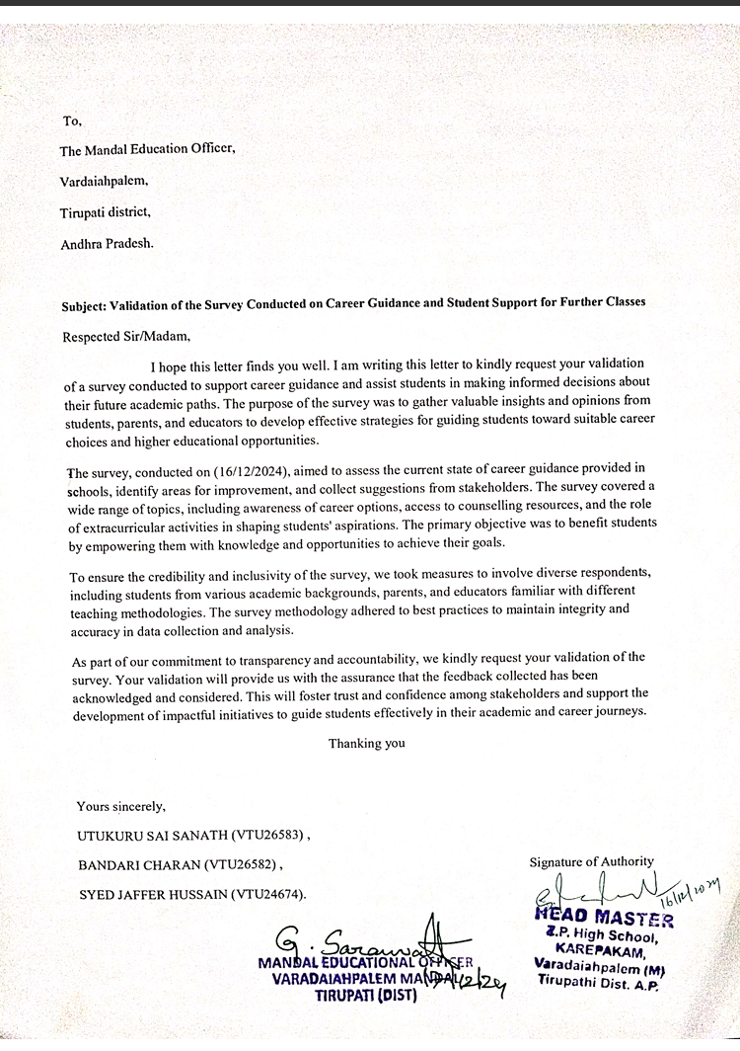
AUTHENTICATED SIGNATURES PROOF AND DETAIL.

Slide 16
RECOMMENDATIONS AND CONCLUSIONS OF THE COMMUNITY SERVICE PROJECT.
Conclusions
The project successfully guided individuals in career planning through workshops, mentorship, and skill-building. Key takeaways:
High demand for career counseling and professional guidance.
Mentorship and real-world exposure enhance career readiness.
Recommendations
Expand Outreach – Reach more schools, colleges, and communities.
Enhance Digital Learning – Create online resources for continuous support..
Provide Long-Term Mentorship – Establish ongoing career guidance programs.
Evaluate Impact – Assess program effectiveness and improve based on feedback.

Slide 17
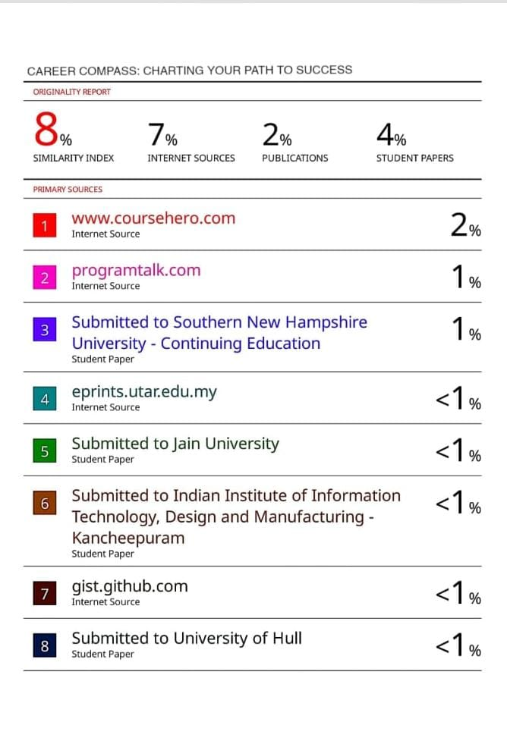
PLAGIARISM REPORT.

Slide 18
THANK YOU

